Slide 1
Generating Breast Cancer IHC Images with Deep Learning Presentation 2
June 18, 2024
Yuchen Li
Xichu Yu
Maiqi Zhou

Slide 2
Contents
Review
Dataset
Methods
Intermediate Results
Task Distribution
Timeline

Slide 3
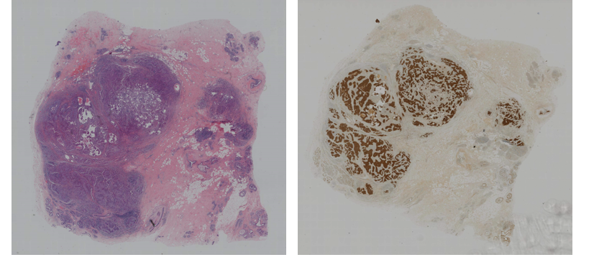
Overview of Initial Proposal
Breast Cancer: A Global Challenge
Breast cancer remains a leading cause of mortality among women worldwide
Effective treatment and accurate diagnosis rely heavily on detailed analysis of histopathological images
Histopathological Images
Hematoxylin and Eosin (HE) and Immunohistochemistry (IHC) stained slices are critical in evaluating breast cancer
An example of HE and IHC stained images
Source: "Breast Cancer Immunohistochemical Image Generation Challenge." grand-challenge.org. https://bci.grand-challenge.org/ (accessed May. 1, 2024)

Slide 4
Overview of Initial Proposal
Challenges with IHC Staining:
The preparation of IHC-stained sections is time-consuming and expensive
IHC staining is typically performed on a single pathological slice, which may not fully represent the status of tumors. HER2 expression level that is diagnosed as 2+ requires further tissue sample
To improve breast cancer diagnosis, we propose training a deep-learning model
This model will perform image-to-image translation from the HE domain to the IHC domain, reducing costs and enhancing diagnostic efficiency
The model will be integrated into existing diagnostic software, enabling adoption in clinical settings

Slide 5
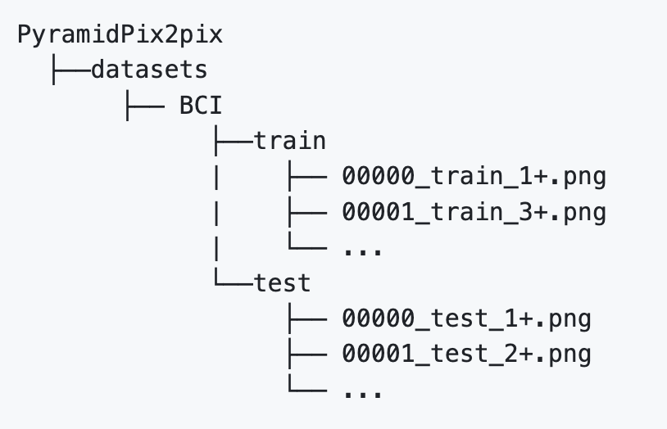
Dataset
Officially available Breast Cancer Immunohistochemical (BCI) dataset
Contains 9,746 images (4,873 pairs)
Already divided into training set and test set
Source: [Bupt AI CZ's BCI Project on GitHub](https://github.com/bupt-ai-cz/BCI)

Slide 6
Method: Dataset Preprocessing
Tool: HistoQC
an open-source software to filter out low-quality images
Filtering Standards:
Flat Areas:
detects smooth (flat) areas in an image by convolving the image with an average filter and comparing it to the original image
Small Tissue Filled Max Area:
sets the upper limit on the size of holes that should be filled within the tissue mask
Blurry Removed Num Regions:
represents the number of regions (or areas) within an image that has been removed due to being identified as blurry

Slide 7
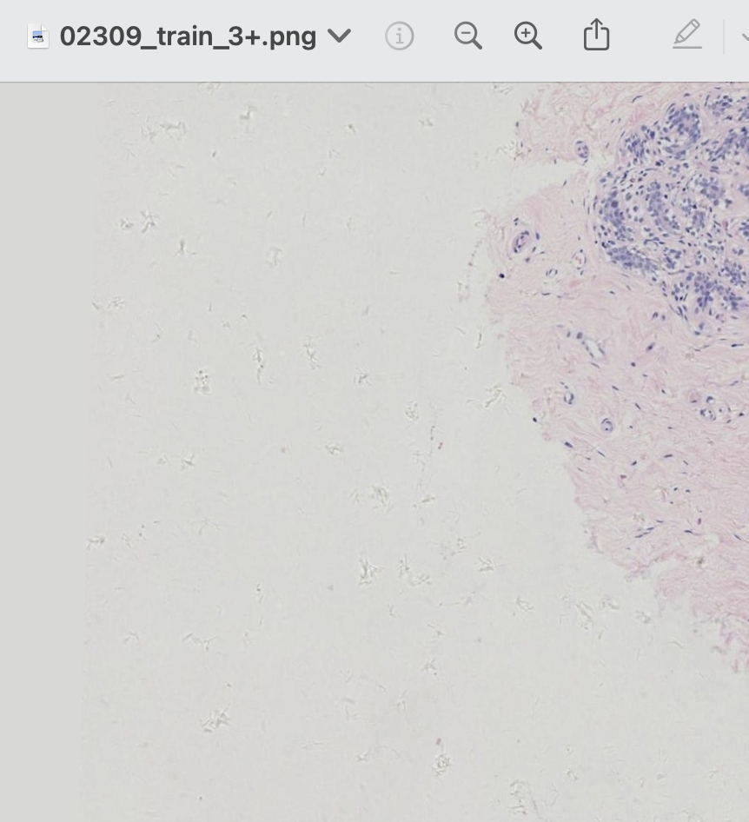
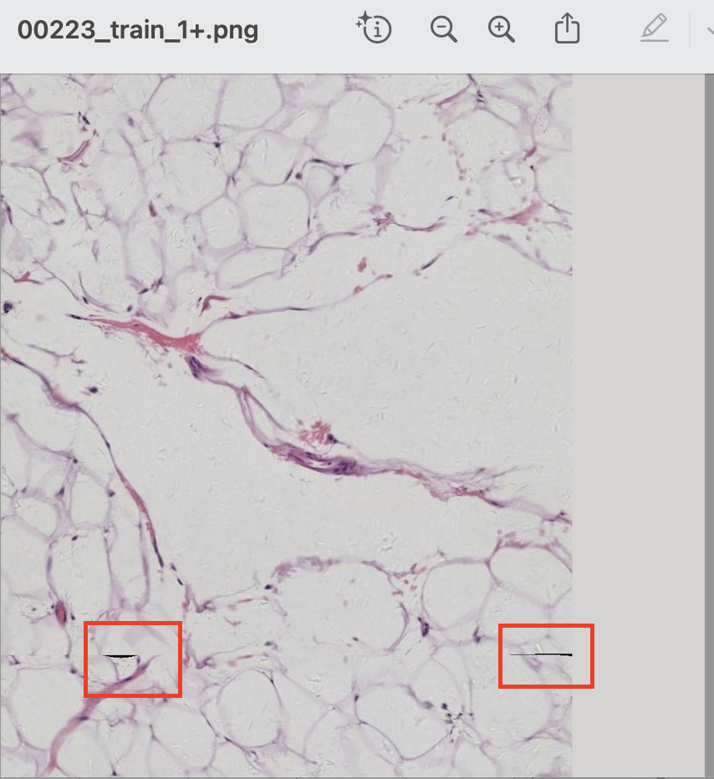
Method: Dataset Preprocessing
Flat Areas:
Small Tissue Filled Max Area:
Blurry Removed Num Regions:

Slide 8
Method: Dataset Preprocessing
Experiment 1:
Filtering Standards:
small_tissue_filled_max_area> 100 & blurry_removed_num_regions > 1
100 epochs on PyramidPix2pix with 128*128 images
Original Pairs | After preprocessing Pairs | Filter Rate
3897 | 3656 | 6.19%

Slide 9
Method: Dataset Preprocessing
Experiment 1:
Filtering Standards:
small_tissue_filled_max_area > 100 & flat_areas > 3
100 epochs on PyramidPix2pix with 128*128 images
Original Pairs | After preprocessing Pairs | Filter Rate
3897 | 3722 | 4.49%

Slide 10
Method: Dataset Preprocessing
Results:
 | PSNR | SSIM
original | 17.46 | 0.59
filtered1 | 19.23 | 0.61
filtered2 | 17.53 | 0.57

Slide 11
Method: Model Design
Pyramid pix2pix Model
Pix2pix Model
Diffusion Model

Slide 12
Pyramid Pix2Pix Model

Slide 13
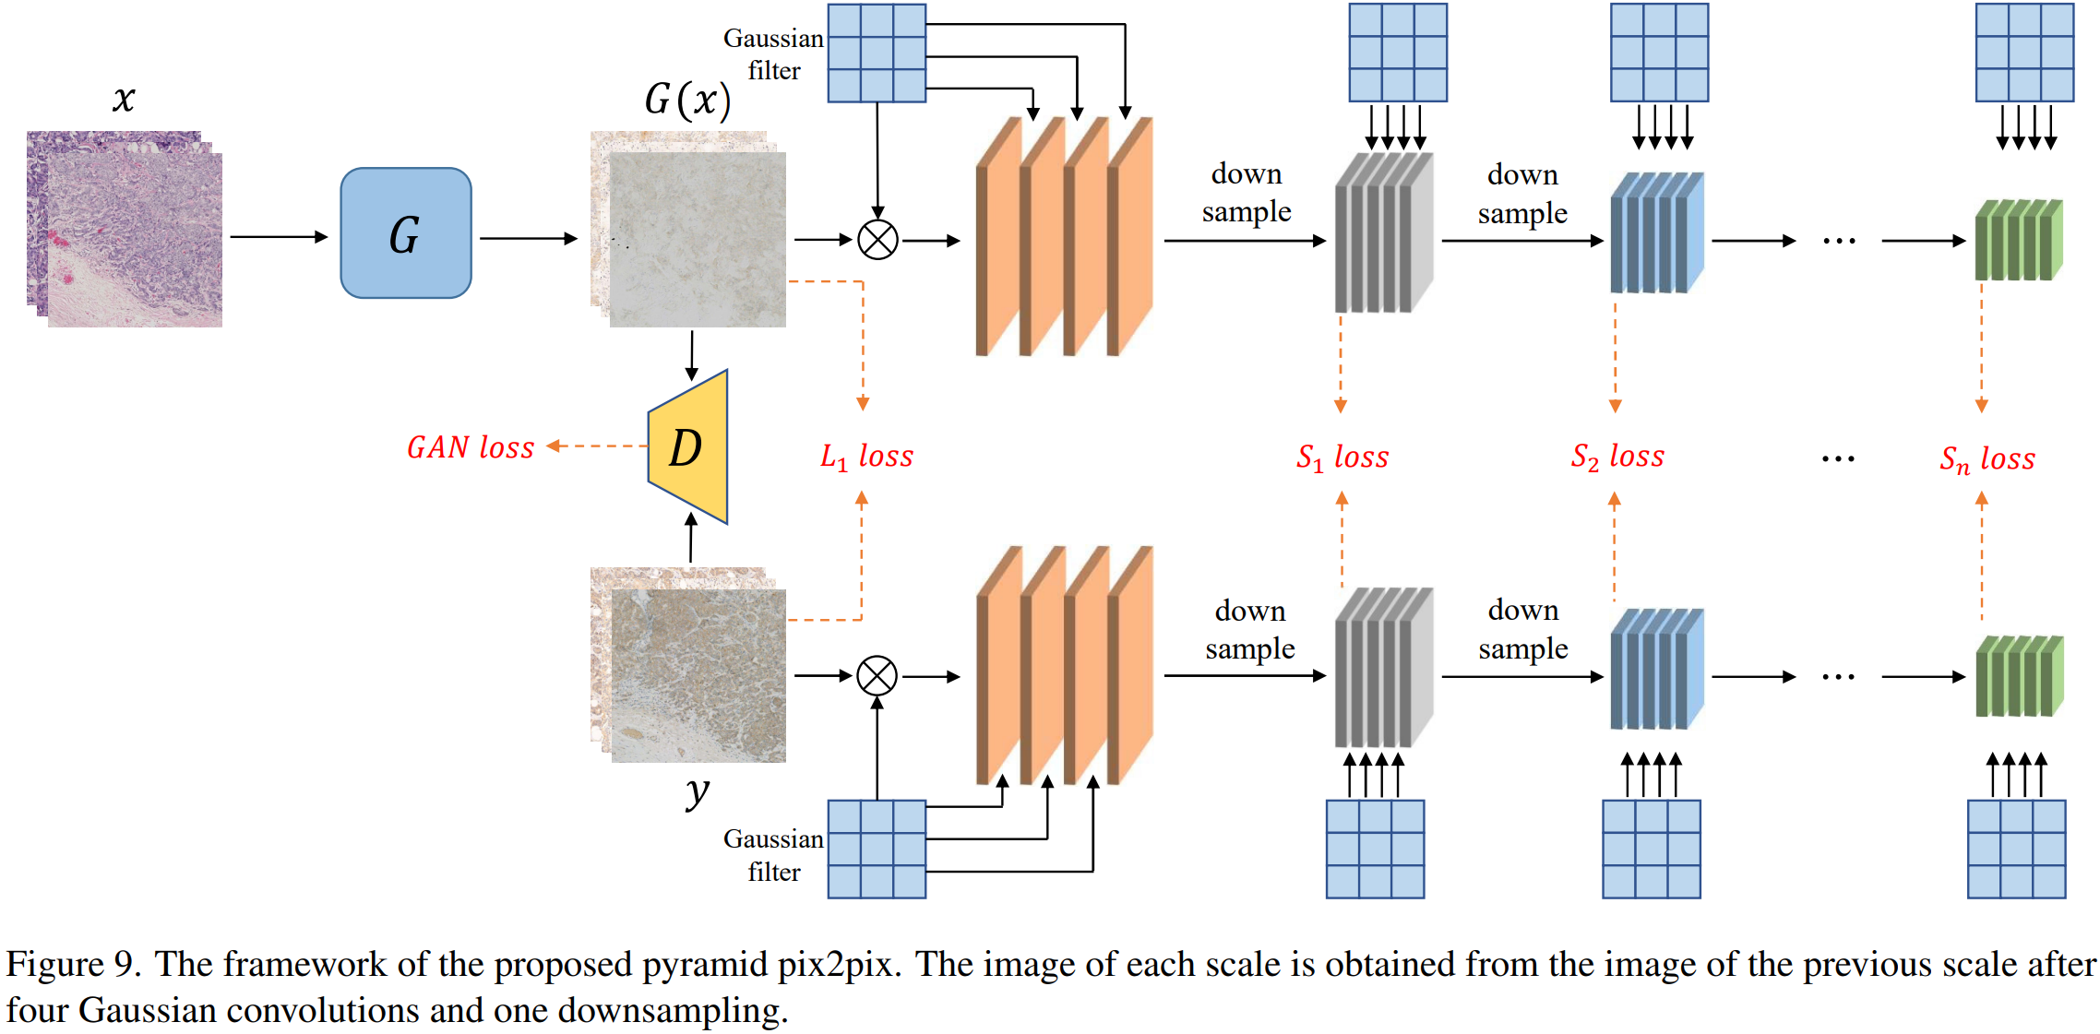
Method: Model Design
Figure: Pyramid Pix2Pix architecture proposed by the challenge organizer.
a type of conditional Generative Adversarial Network (cGAN)
We apply this model using the preprocessed data set, following the strategy of the competition's winner.
Source: Liu et al. "Bci: Breast cancer immunohistochemical image generation through pyramid pix2pix." In *Proceedings of the IEEE/CVF conference on computer vision and pattern recognition*, pp. 1815-1824. 2022.

Slide 14
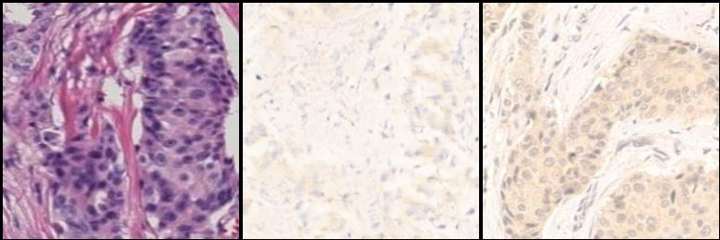
Results
Real A
Fake B
Real B

Slide 15
Pix2Pix Model

Slide 16
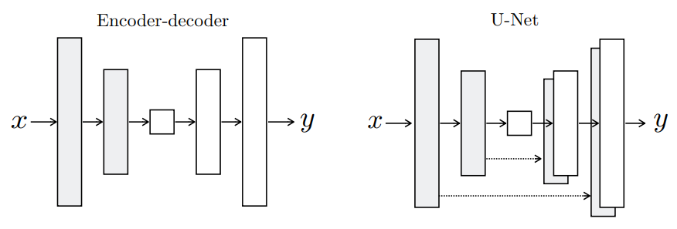
Model Design
Generator: U-Net
Downsampling section (encoder): 8 downsampling blocks
Upsampling section (decoder): 8 upsampling blocks
Final output layer: A 3x3 Conv layer Loss: Adversarial Loss + L1 loss
Discriminator: PatchGan
Conv layer 1: A 3x3 Conv layer
3 downsampling blocks
Final output layer: A 4x4 Conv layer
Loss: Binary Cross Entropy Loss
Isola, Phillip, et al. "Image-to-image translation with conditional adversarial networks." Proceedings of the IEEE conference on computer vision and pattern recognition. 2017.

Slide 17
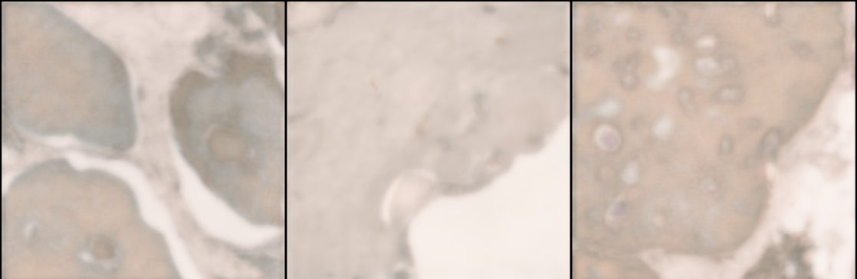
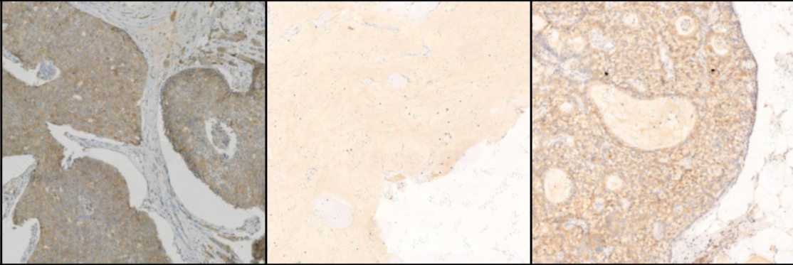
Results
Fake IHC image
Real IHC image
lack of detail
lack of clarity

Slide 18
Diffusion Model

Slide 19
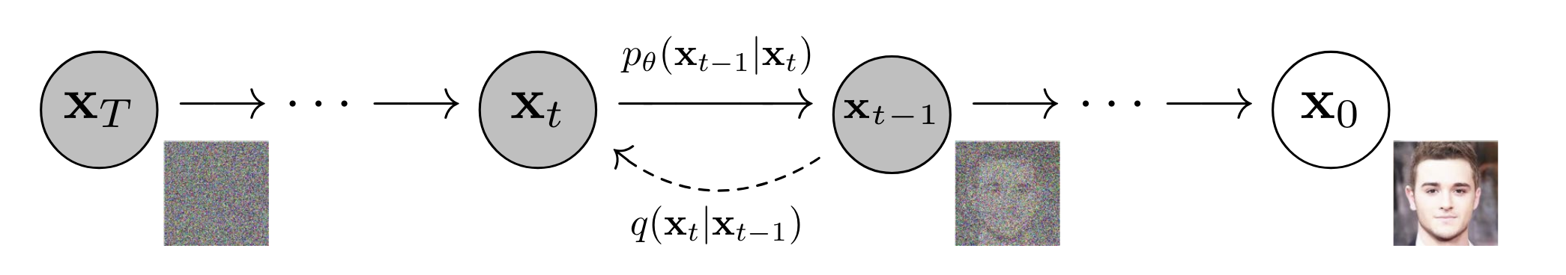
Background
Diffusion Probabilistic Model
A parameterized Markov chain trained using variational inference to generate samples matching the original data after a finite period.
A type of Markov chain that gradually adds noise to the data until the original signal is destroyed.
Ho et al. "Denoising diffusion probabilistic models." Advances in neural information processing systems 33 (2020): 6840-6851.

Slide 20
Key features
Gaussian Noise:
When the diffusion involves small amounts of Gaussian noise, the sampling chain transitions can be set to conditional Gaussians
Neural Network Parameterization
Straightforward neural network implementation, making the process efficient to train
Ho et al. "Denoising diffusion probabilistic models." Advances in neural information processing systems 33 (2020): 6840-6851.

Slide 21
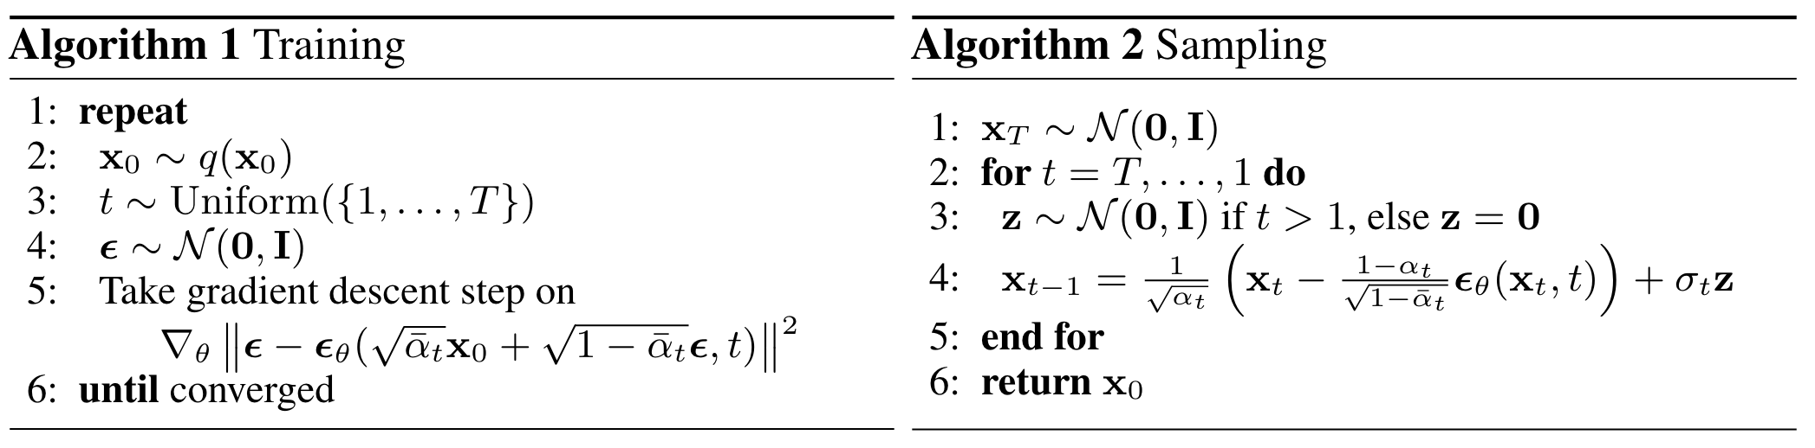
Basic algorithms
Training objective:
Minimizing the mean squared error (MSE) of noise prediction for given timestep T
Ho et al. "Denoising diffusion probabilistic models." Advances in neural information processing systems 33 (2020): 6840-6851.

Slide 22
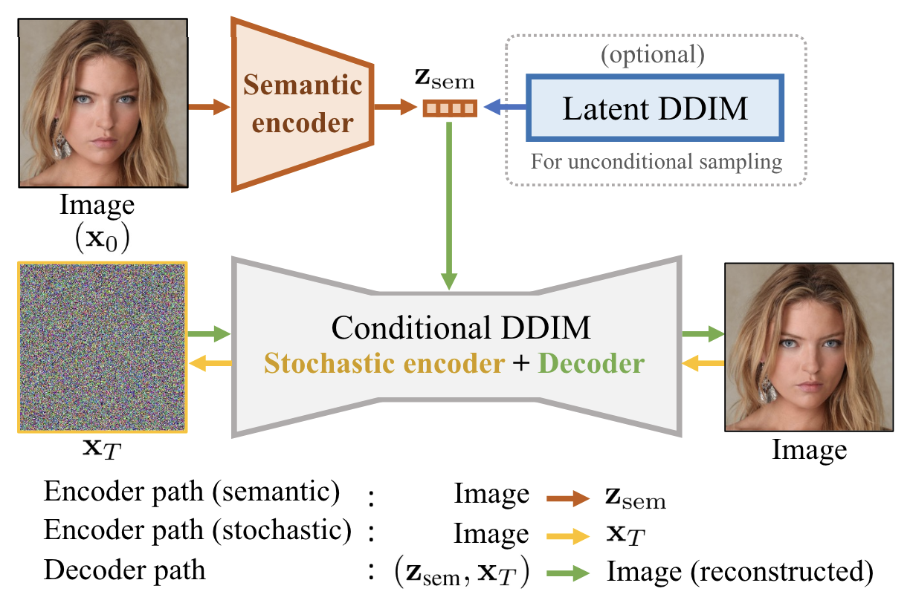
Diffusion Autoencoder
Hybrid model combining autoencoders and diffusion principles
Encoding data into a low-dimensional latent space, applying diffusion process, and decoding back
Additional semantic encoder to guide the diffusion model with semantic information

Slide 23
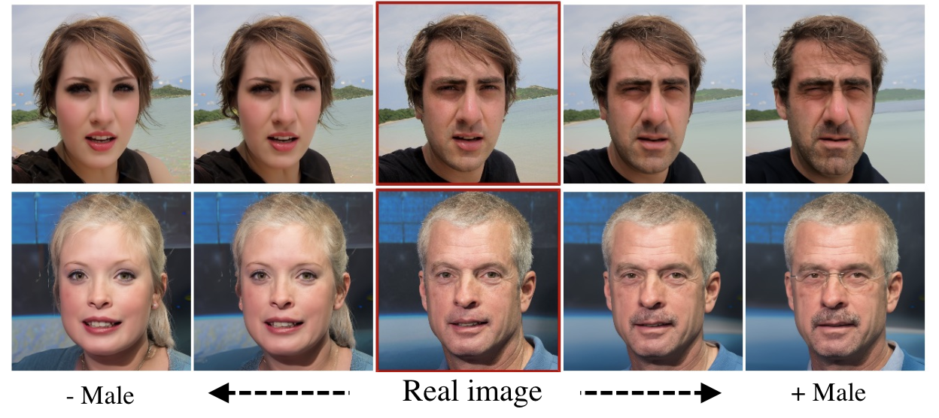
Diffusion Autoencoder
Example of attribute manipulation based on latent interpolation

Slide 24
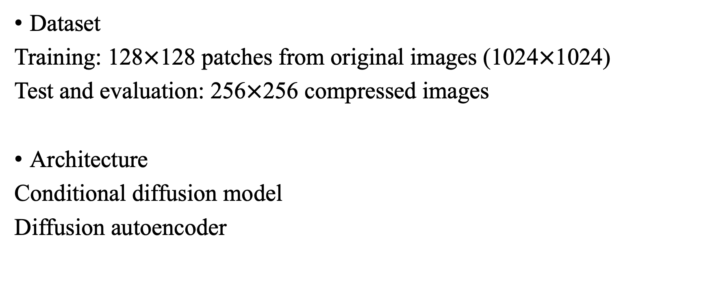
Methods

Slide 25
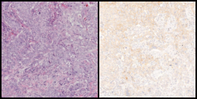

Results
Left: Ground truth
Right: Sampled
Conditional diffusion model
100 epochs

Slide 26
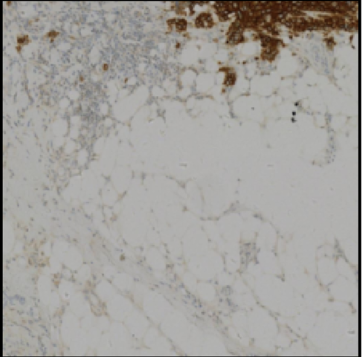
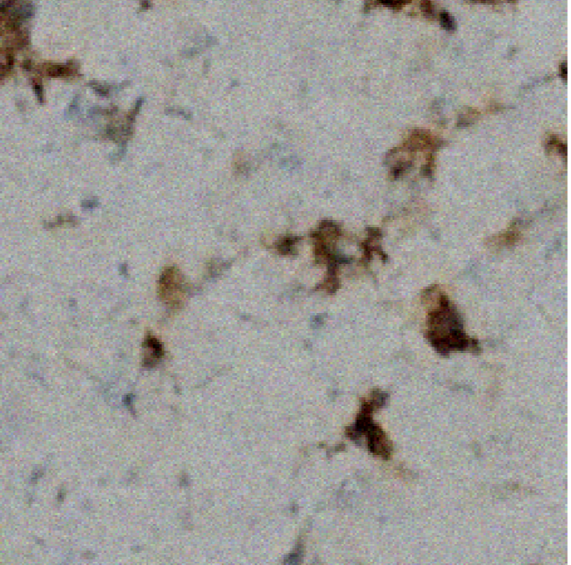
Results
Left: Ground truth
Right: Sampled
Diffusion autoencoder
100 epochs

Slide 27
Discussion
Overview of current experiments:
Lack of computational resources
No promising result yet
Novel method proposed
Next steps:
Keep working on diffusion autoencoder
More systematic experiments to finetune our model

Slide 28
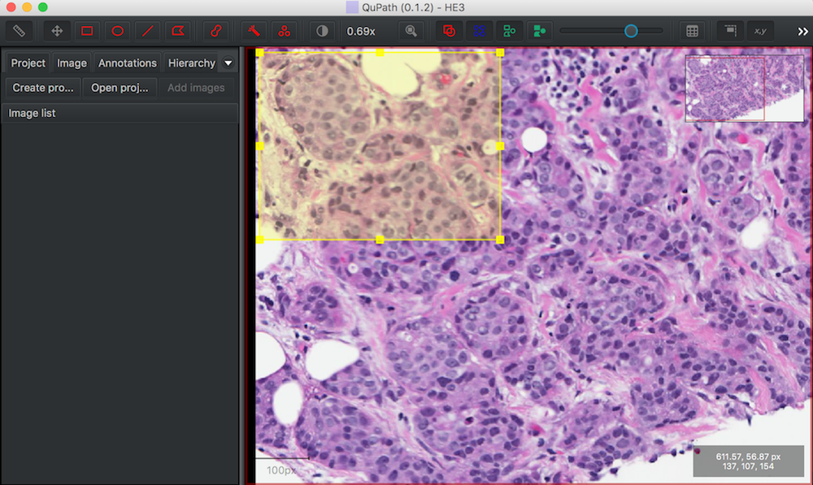
Method: Software Design
QuPath
Open-source pathology image analysis software.
Support customizable extensions.
We plan to develop a python extension that will integrate our model to QuPath with user-friendly functions.
Source: D. Breen, "H&E Histology Color Normalization - QuPath," Drexel University, 2018. [Online]. Available: https://www.cs.drexel.edu/~deb39/ZarellaLab/h-e-histology-color-normalization_qupath.html. [Accessed: 12-May-2024]

Slide 29
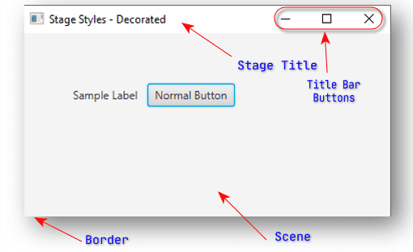
Method: Software Design
JavaFX
A software platform for creating and delivering desktop applications with a modern user interface.
FXML: XML-based language to define UI components (though Java code can also be used directly).
The template of Qupath extension provided imports javafx, making it easy to build complex interfaces.
Source: https://owlcation.com/stem/JavaFx-Stage-Styles[Accessed: 12-June-2024]

Slide 30
Method: Software Design
QuPathExtension Interface
- Integrates with QuPath
- Manages initialization
interface.fxml
- Defines UI layout
Controller
- Handles UI logic and events
JavaFX platform
QuPath Framework

Slide 31
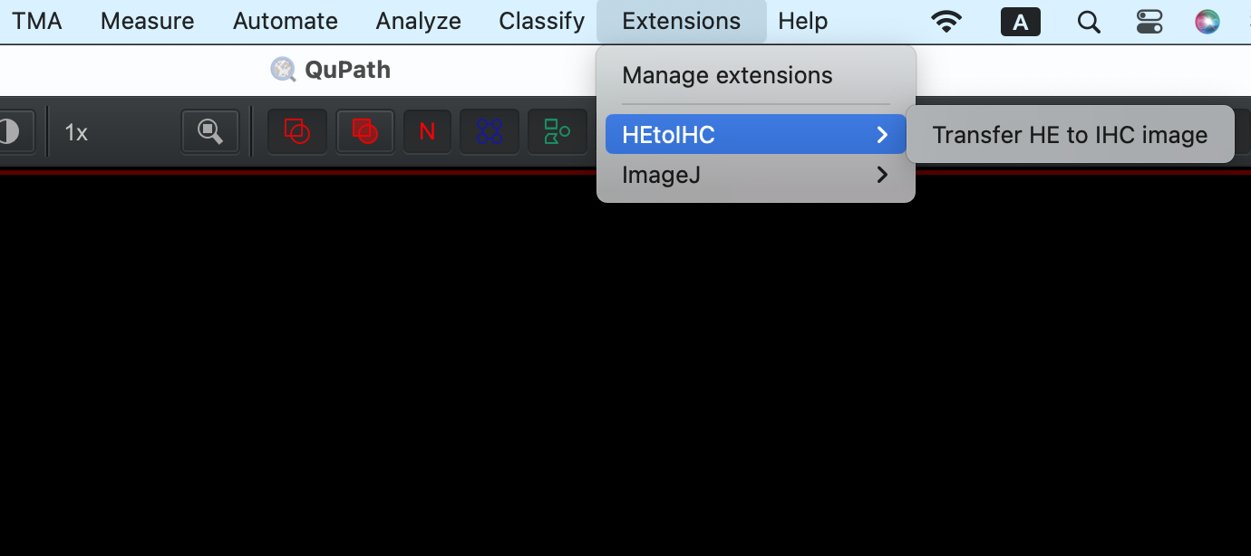
Method: Software Development

Slide 32
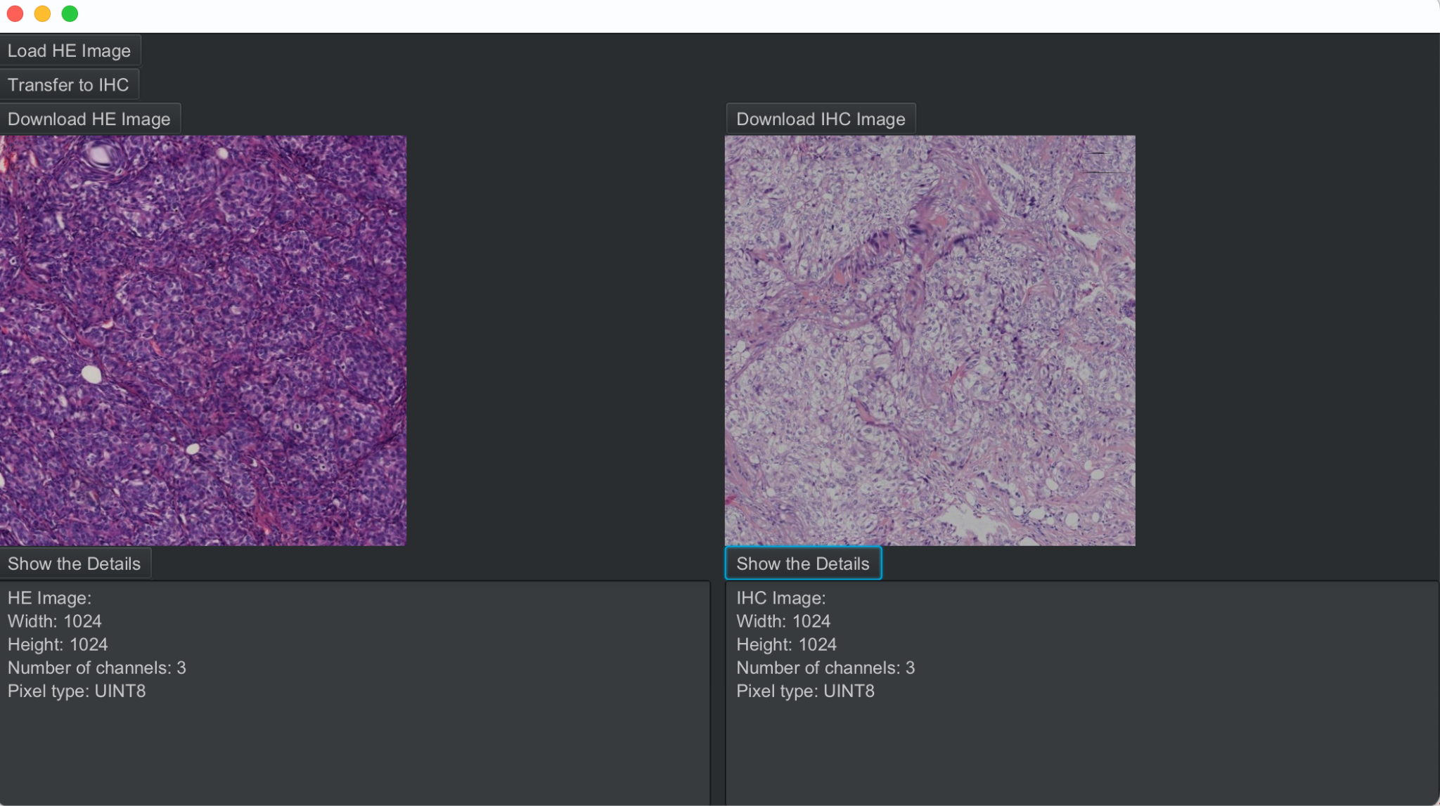
Method: Software Development

Slide 33
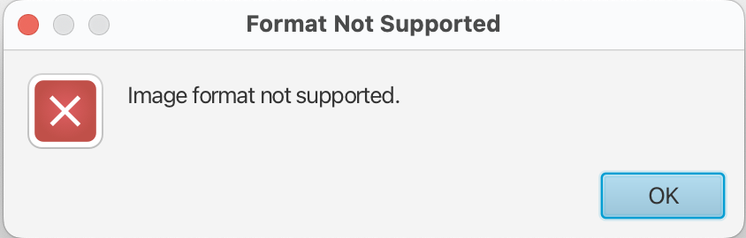
Method: Software Development
Test Case 1: Load an incorrect image format such as .txt

Slide 34
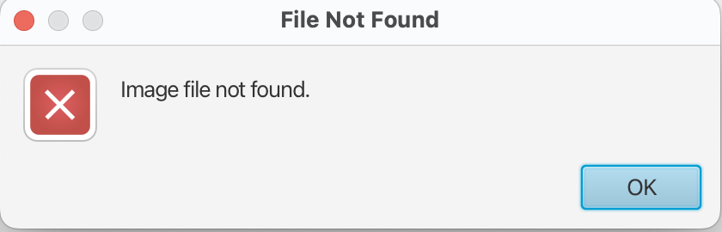
Method: Software Development
Test Case 2: Give an incorrect image path

Slide 35
Task distribution
Task | Member
Preprocessing the dataset | Maiqi Zhou
Development of software system | Maiqi Zhou
Pix2Pix Model | Xichu Yu
Diffusion Models | Yuchen Li
Experimental Design | Yuchen Li

Slide 36
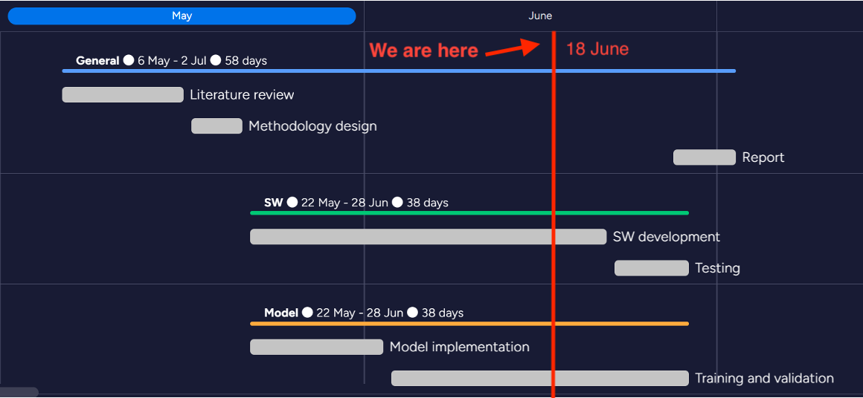
Time schedule
Task | Timeline
Literature review | 6-16 May
Methodology design | 17-21 May
Model implementation | 22 May-2 Jun
Training and validation | 3-28 Jun
Software development | 22 May-21 Jun
Testing | 22-28 Jun
Report | 27 Jun-2 Jul

Slide 37
Outlook
Perform a comparison between the original dataset and the processed dataset to identify better parameters for data preprocessing
Enhance the user interface (UI) code to improve user friendliness
Refine the testing section, conducting both black box and white box testing
Keep working on model training and refinement

